Slide 1


A Data-Driven Visualization and prediction
Study of conflict Impacts on Education and
Food Security in Gaza
Dr.Hussam Barham
Kamal Alabweh
201911362
Jana Alsharif
202210856

Slide 2

Introduction
This project focuses on analyzing the impact of armed conflict on civilian systems, with a specific emphasis on food system impacts and education in Gaza. The study adopts a Business Intelligence and data analysis approach to examine how political and conflict-related dynamics affect these critical sectors.
Based on this perspective, the project was designed using verified humanitarian data obtained from the Humanitarian Data Exchange (HDX), combined with supporting media data to strengthen contextual understanding.
K&J

Slide 3
Data Processing and Visualization
Structured Analytical Workflow
Advanced Analytics Integration
To achieve the project objectives, a structured analytical workflow was applied, including:
Furthermore, Natural Language Processing (NLP) techniques—specifically machine learning-based methods—were applied to analyze media coverage related to food security.
Data collection from verified humanitarian sources
Data cleaning to ensure accuracy and consistency
This integration enabled the linkage between quantitative charts and media narratives, providing a more comprehensive and holistic analytical view that connects numerical patterns with real-world events and media reporting.
Data transformation for analytical readiness
Interactive data visualizations were developed to support exploratory data analysis and enhance analytical interpretation. These visualizations play a critical role in supporting decision-making and reinforcing the analytical value of the findings.
K&J

Slide 4
Datasets, Tools, and Project Objective
1
2
Primary Datasets
Analytical Tools
Incidents Affecting Food Systems (2023–2025): More than 1,000 records documenting attacks on food infrastructure
Several analytical tools were utilized, including Excel, Power BI, and Python, to ensure accurate and effective implementation of the project across all analytical phases.
Incidents Affecting Education (2020–2024): Approximately 300 records of education sector impacts
3
4
Core Challenge
Project Goal
A large volume of humanitarian data related to Gaza exists primarily as raw records or textual reports, limiting actionable insights.
Transform data from records into insights by answering: What is happening? When is it happening? Where is it happening?
Using Power BI, the analysis answers fundamental questions about conflict patterns. To further enhance the analysis, Python and NLP were incorporated to connect numerical patterns with media coverage and real-world events. As a result, the project evolved from standalone dashboards into an integrated analytical framework.
K&J

Slide 5
Dashboard
Food Systems

Slide 6
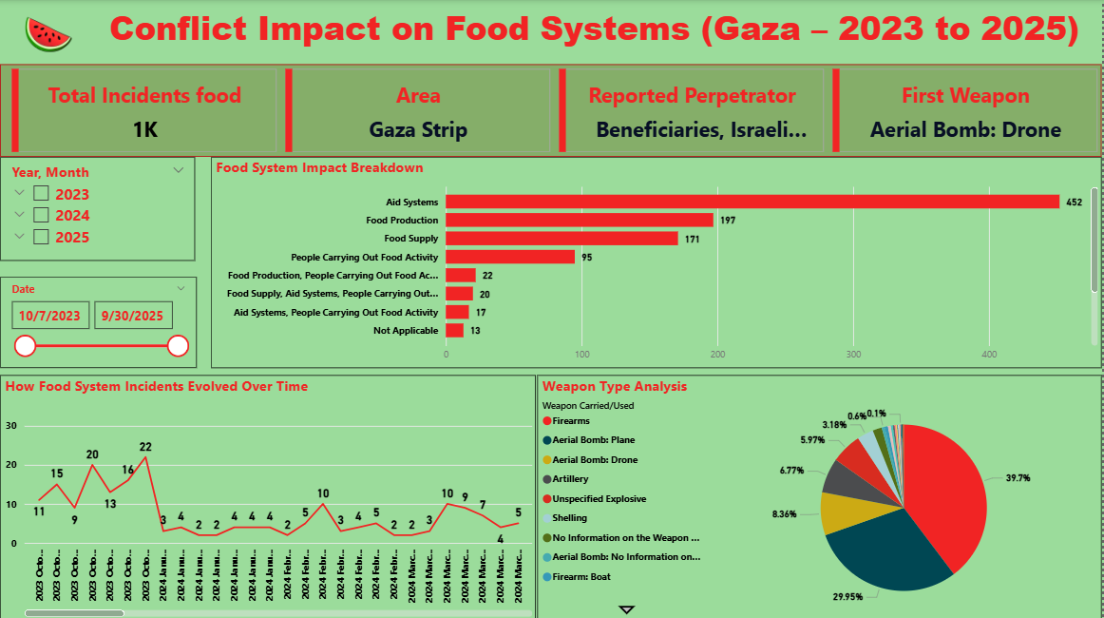
Dashboard Design and Data Preparation
This dashboard was designed and formatted using a color scheme inspired by the Palestinian flag. The purpose of this design choice was to ensure that the dashboard is visually comfortable while also reflecting the humanitarian context of the events being analyzed, allowing the viewer to remain connected to the subject matter while interpreting the data.
The selected chart types were chosen deliberately, as they best support the intended analytical objectives and allow the data to be represented in a clear and meaningful manner.
The analysis begins with KPI Cards, which were used to highlight the most important variables and key columns within the dataset, providing an immediate overview of critical information.
Prior to visualization, the data was cleaned and prepared using Power Query, ensuring that all fields were properly formatted, consistent, and suitable for accurate analytical representation.
K&J

Slide 7
Interactive Filtering and Impact Analysis
01
02
Interactive Slicers
Food System Impact Breakdown
Two slicers were implemented: the first allows filtering by year with dropdown for months; the second enables filtering by specific dates or custom date ranges for focused analysis.
Analysis illustrates which components were most affected. The aid system represents the most severely impacted component, indicating humanitarian aid infrastructure was the primary target.
03
04
Enhanced Interpretation
Weapon Type Analysis
A tooltip displays all food security categories, including destruction of agricultural land, damage to food-related equipment, and disruption of food production systems.
Firearms appear as the most frequently reported weapon. "No Information" represents incidents where weapon type could not be identified due to documentation challenges during active conflict.
This directly contributes to severe shortages in humanitarian assistance, as warehouses and food storage facilities were systematically targeted throughout the conflict period.
K&J

Slide 8
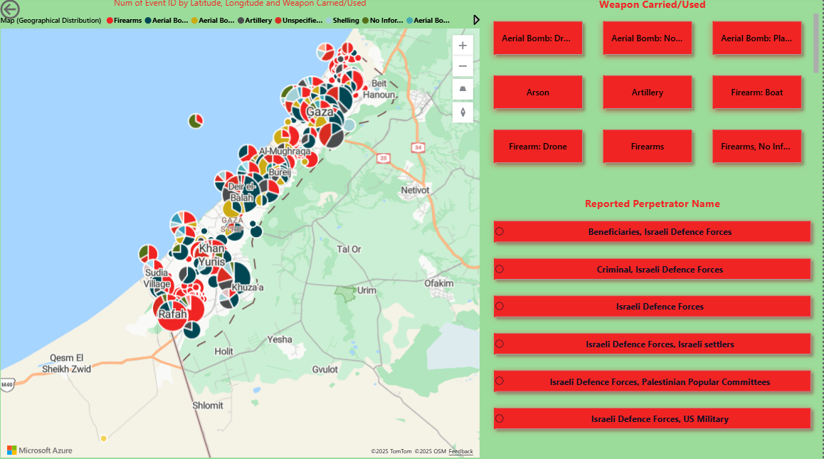
Temporal and Spatial Patterns of Food System Targeting
Temporal Analysis
Spatial Analysis
A line chart was utilized as one of the most critical visualizations, as it enables the identification of escalation periods and highlights specific months and years during which attacks on food systems increased significantly.
Maps were used as a key spatial visualization tool, as they allow precise geographic analysis. Checkbox filters were applied for weapon type and reported perpetrator, enabling users to identify which specific areas were targeted and under what conditions.
By linking time with food system impacts, the analysis demonstrates that the conflict is not a static event, but rather a continuously evolving crisis with daily changes.
Among all visualizations, the line chart and the map are considered the most important, as they jointly connect temporal analysis with spatial analysis.
This provides a comprehensive understanding of how and where food systems were targeted over time, revealing patterns of systematic disruption to civilian food infrastructure.
K&J

Slide 9
Media
Line Chart and News

Slide 10
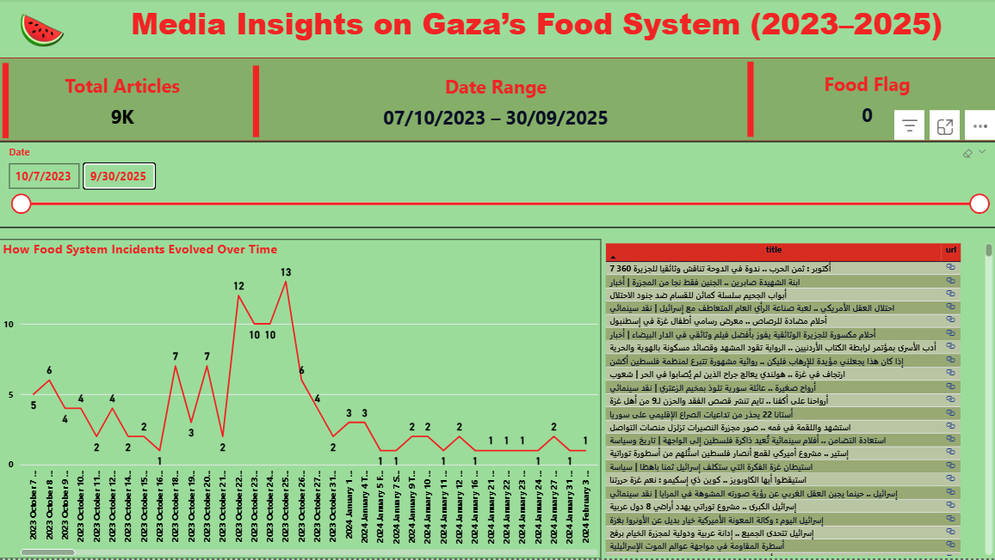
Linking Line Chart Analysis with Media Data
Building on the line chart analysis, we enhanced the interpretation by linking the temporal trends with media coverage. This was achieved by creating a connection between Al Jazeera's news content and our dashboard through news data collected from the GDELT Project API (Global Database of Events, Language, and Tone).
This integration allowed us to associate the patterns observed in the line chart with real-world events reported in the media, thereby strengthening the interpretation of escalation periods related to food system impacts .
K&J

Slide 11
Media Data Structuring and Daily Extraction Approach
Unstructured to Structured
Daily Extraction
Transform news text into structured dataset suitable for tabular analysis
Retrieve news articles daily from 07/10/2023 to 30/09/2025
Volume Management
Automated Integration
Up to 200 articles per day due to API constraints
Custom code in Power BI Advanced Editor for seamless data retrieval
In order to analyze news content effectively, it was necessary to transform the data from unstructured text into a structured dataset suitable for tabular analysis. The system was configured to collect up to 200 news articles per day. This limitation was applied due to API constraints, as retrieving a larger volume of articles may prevent proper processing and analysis in a tabular format.
The extraction logic was implemented through custom code and integrated directly into Power BI using the Advanced Editor, allowing automated data retrieval and seamless integration with the dashboard for real-time analytical updates.
K&J

Slide 12
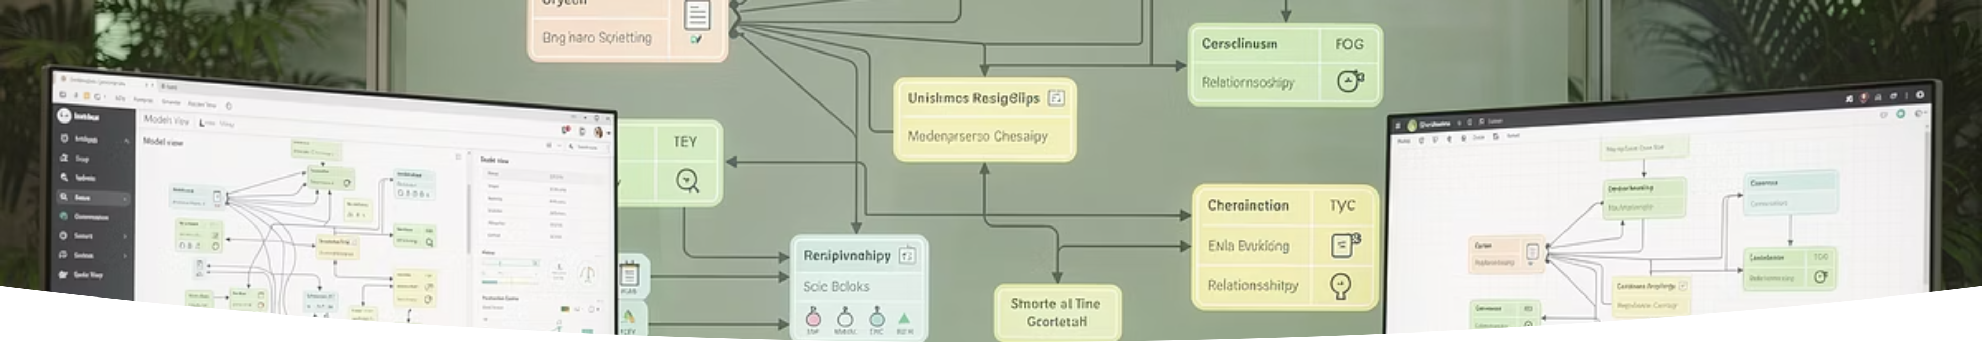
Data Model Relationships
Table Relationship
Interactive Filtering
A relationship was created between two tables:
When a user clicks on a specific date in the line chart, the dashboard automatically filters and displays the news articles published on that same day.
The Food System Impact table
The Al Jazeera News table containing approximately 18,000 articles
This functionality strengthens the linkage between quantitative temporal trends and qualitative media context, allowing analysts to understand both the statistical patterns and the narrative context of events simultaneously.
This relationship was established to enable cross-filtering functionality within the dashboard environment.
K&J

Slide 13
Dashboard
Education Systems

Slide 14
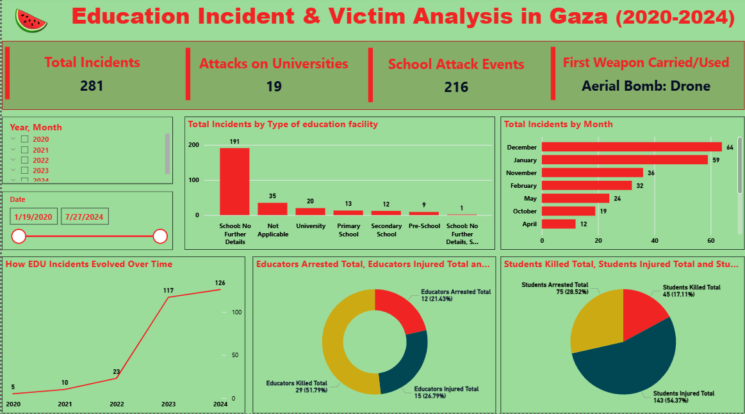
Education Incidents and Facility Impact in Gaza (2020–2024)
This section analyzes the impact of armed conflict on the education sector in Gaza during the period from 2020 to 2024. The analysis examines education-related incidents in terms of the total number of incidents, the type of educational facilities affected (schools and universities), and their temporal distribution.
KPI Cards Overview
Facility Type Analysis
Enhanced Spatial Context
KPI Cards were used to highlight the most important columns and key indicators, providing a high-level overview of the education incidents data.
The analysis of total incidents by education facility type shows that schools were the most heavily targeted, indicating the severe impact of conflict on school-level education.
A tooltip was added to display the affected area and the count of event IDs, representing the number of recorded incidents at each location and enhancing the spatial interpretation of the data.
K&J

Slide 15

Temporal Trends in Education-Related Incidents
Monthly Distribution Analysis
Contextual Enrichment
The total incidents by month visualization illustrates how education-related incidents are distributed across different months throughout the study period.
To enrich the analysis, a tooltip containing a data description was incorporated, providing contextual explanations of the key events that occurred during each month.
This chart enables the identification of periods with increased disruption to the education sector, revealing patterns of systematic targeting during specific timeframes.
This supports a deeper understanding of the observed temporal patterns and connects statistical trends with documented real-world events affecting educational institutions.
K&J

Slide 16



Human Impact and Escalation Trends
40%
35%
25%
Students Killed
Students Injured
Students Arrested
Percentage of student casualties in education-related incidents
Proportion of students wounded during attacks on educational facilities
Share of students detained in education-related incidents
Donut and pie charts were used to visualize the impact of conflict on students and educators, categorizing incidents into killed, injured, and arrested. These visualizations clearly illustrate both the severity and type of harm experienced by each group.
Finally, a line chart was used to link education-related datasets over time. The chart reveals a clear escalation in incidents during the period from 2023 to 2024, highlighting a significant increase in conflict-related impacts on the education sector and reinforcing the overall trend of intensifying disruption to educational infrastructure and personnel.
K&J

Slide 17
Machine Learning

Slide 18
Motivation for Machine Learning and Data Collection
Challenge Identification
Pipeline Design
Power BI filtering limitations with large volumes of unstructured news data
Three-stage pipeline: data collection, classification, output generation
1
2
3
ML Objective
Efficiently identify food-security-related articles using semantic embeddings
The introduction of Machine Learning (ML) was motivated by a limitation observed in the native filtering capabilities of Power BI, particularly when dealing with large volumes of unstructured news data. The main objective was to efficiently identify and extract food-security-related news articles by transforming news titles (text) into semantic embeddings.
The Python code was designed as a three-stage pipeline. The first stage focuses on data collection, where a specific time period and search criteria are defined. An API-based approach is then used to retrieve news articles on a daily basis, ensuring consistent and systematic data acquisition over time.
K&J

Slide 19
Hybrid Information Retrieval Model Design
Stage 2: Hybrid Classification
The second stage applies a hybrid classification approach using two complementary methods to identify food-related news articles.
Method 1: Exact Food Match
Relies on matching predefined food-related keywords directly with the news title for explicit identification.
Method 2: Semantic Similarity
Calculates similarity score using multilingual embedding model to capture implicit references to food security without explicit keywords.
Stage 3: Structured Output
Final stage outputs results as a structured CSV table for integration with analytical tools.
To implement this pipeline, several Python packages were used, including: requests, pandas, sentence-transformers, torch, datetime, and time.
This hybrid approach combines the precision of keyword matching with the contextual understanding of semantic similarity, enabling more comprehensive identification of food-security-related content in news media.
K&J

Slide 20
Accuracy

Slide 21
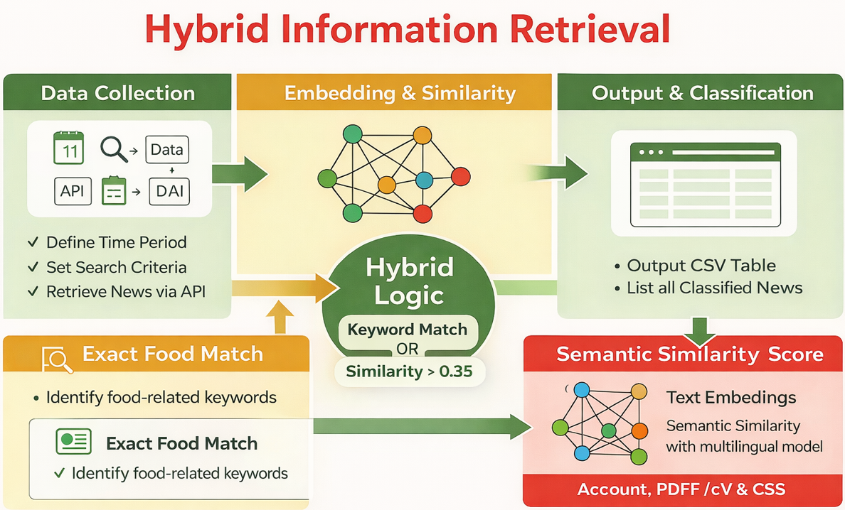
Accuracy Considerations and Model Limitations
The model was configured with a semantic similarity threshold greater than 0.35, which defines the minimum similarity required for an article to be classified as food-related. In addition, a targeted list of keywords was defined to support the ML model in understanding the relevant food-security-related terminology.
This approach is classified as Hybrid Information Retrieval, as it combines exact keyword matching with semantic similarity scoring. For this reason, the model differs from traditional supervised machine learning approaches.
Conventional accuracy metrics were not applied because the model does not rely on labeled training data. Instead, performance is governed by the semantic similarity threshold, which directly influences sensitivity and precision.
To further improve the model and address its current limitations, future enhancements should include expanding the textual input beyond titles to incorporate full-text articles or article descriptions, which would provide richer context and improve classification reliability.
K&J

Slide 22
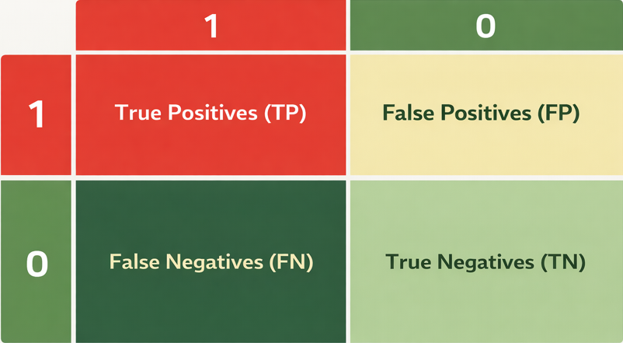
Classification Logic and Model Decision Process
This section explains the classification logic used in the model, based on True Positives (TP), True Negatives (TN), False Positives (FP), and False Negatives (FN).
The primary task of the model is to determine whether a news article is food-related (1) or not food-related (0). The classification decision is based on the model’s output, which represents a combination of:
Keyword matching
Semantic similarity score
Following classification, the model’s output is compared against a manual ground truth assessment, which serves as a reference for evaluating the correctness of each prediction.

Slide 23
Conclusion

Slide 24
Conclusion
In conclusion, this project was not merely an exercise in data presentation or dashboard creation. Rather, it represents an attempt to build an integrated Business Intelligence framework that addresses a real humanitarian challenge related to food security and education in Gaza.
Through the use of Power BI, the data was transformed from raw records into clear and actionable insights, answering fundamental analytical questions such as: what is happening, when it is happening, where it is happening, and at what scale.
Furthermore, by incorporating Python and Natural Language Processing, the project added a contextual dimension to the analysis through the examination of media coverage. This approach enabled the linkage between quantitative analysis and the surrounding narrative of the conflict, providing a more comprehensive understanding of events.
In addition, the evaluation methodology based on True Positives, True Negatives, False Positives, and False Negatives provided a transparent and extensible framework for assessing model performance, even in the absence of labeled training data.
K&J

Slide 25
Beneficiaries and Final Remarks
The primary beneficiaries of this work include decision-makers, humanitarian organizations, and researchers. The project provides an analytical tool that supports a deeper understanding of the temporal and spatial patterns of humanitarian impact, enabling improved planning, priority setting, and data-driven decision-making, rather than reliance on purely descriptive reports.
Overall, this project demonstrates how Business Intelligence can be effectively combined with Advanced Analytics to move beyond traditional reporting and toward real decision-support tools that are scalable and adaptable for future applications.
K&J

Slide 26


